Slide 1
BIOE 498 / BIOE 599 Advanced Biological Control Systems Lecture 1: Course Introduction
Joseph L. Hellerstein
March 28, 2022
eScience Institute, Computer Science & Engineering
Allen School of Computer Science
BioEngineering
Notes:
Diverse students. Some with bio-backgrounds; some without. Some with CS background; some with very limited. Two separate courses combined because of a substantial shared curriculum.

Slide 2
Agenda
What is control engineering and why it’s important
Course overview
Biochemistry basics
Lecture Notes: canvas/syllabus

Slide 3
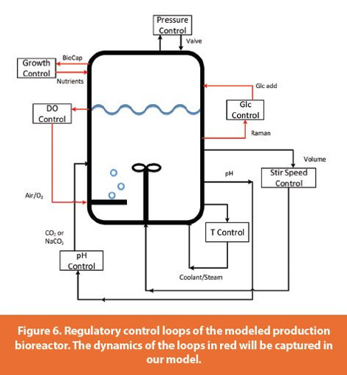
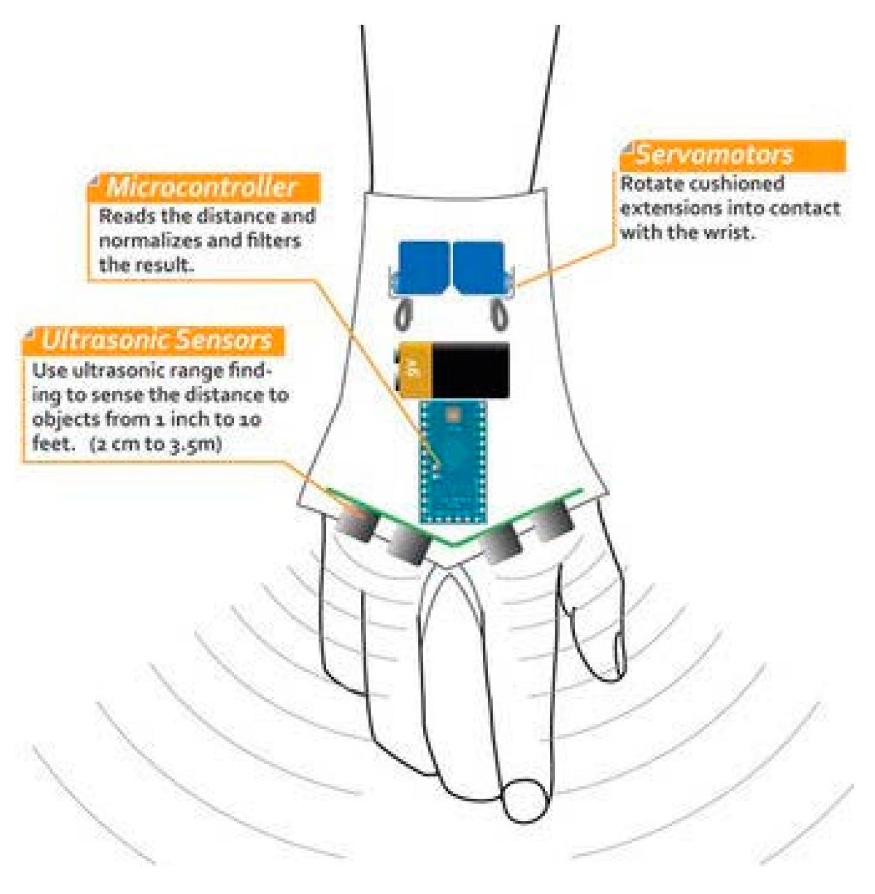
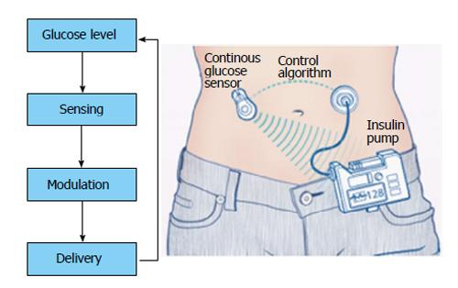
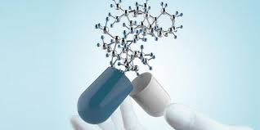
Why Control Engineering?
Bioreactor Control
Medical Device Control
Insulin Control
Create a system that:
ensures that bounded inputs produce bounded outputs;
regulates its output;
tracks a desired objective;
minimizes cost, energy, potential dangers.

Slide 4

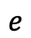
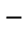
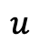
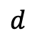
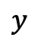
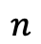
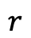
Elements of a Control System
operator
$$d$$
$$n$$
user
Controller
“Plant”
x₁, …, x_{n}
+
+
actuators
sensors
+
$$r$$
$$−$$
$$e$$
$$u$$
$$y$$
x₁, …, x_{n} are plant state variables that completely determine its outputs
r is the reference input specified by the operator
u is the control input to the plant
y is the plant output that is being controlled
e is the control error, r-y
d is a disturbance that impacts how u relates to the x’s
n is noise that impacts the observed output y

Slide 5

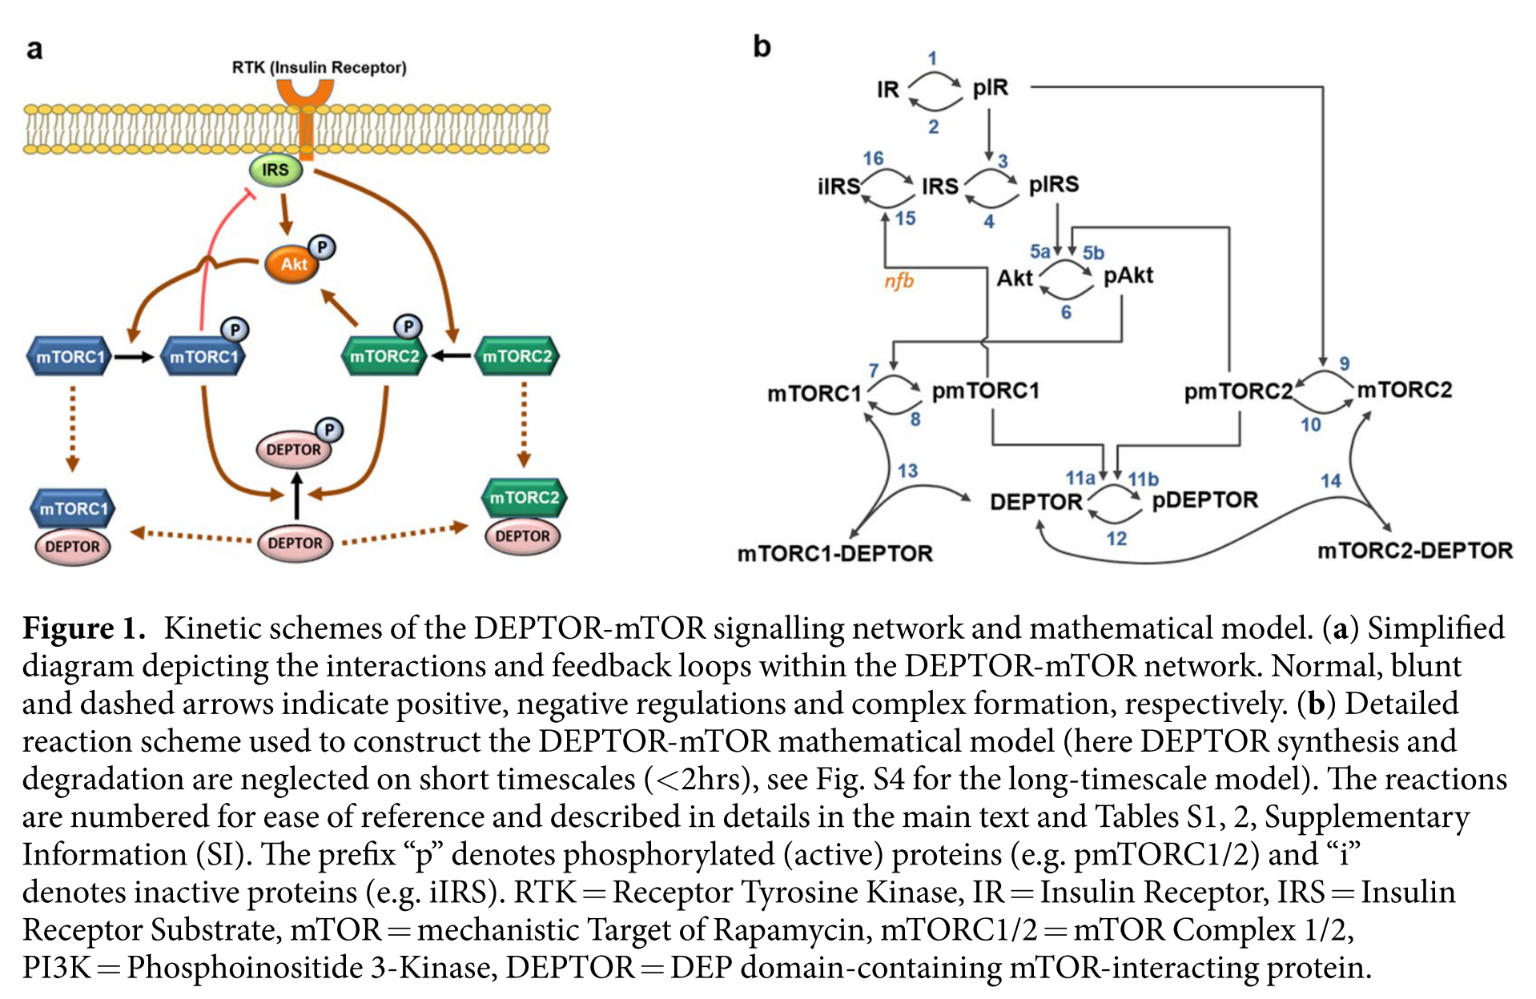
An Example: mTOR Signaling

Slide 6
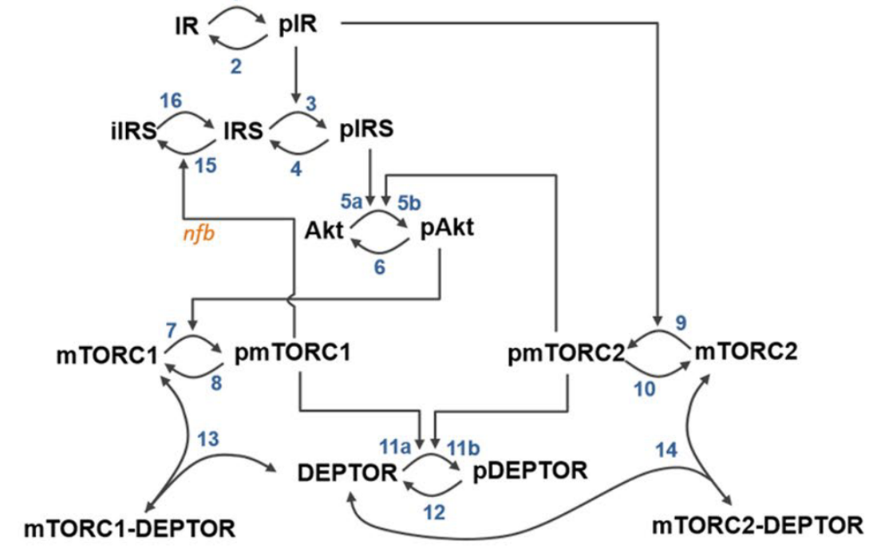
Challenges With Control Engineering in Systems Biology
What are the actuators? What are the sensors?
Effect of actuators given complex internal feedbacks.
Handling noise and disturbances.

Slide 7
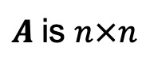
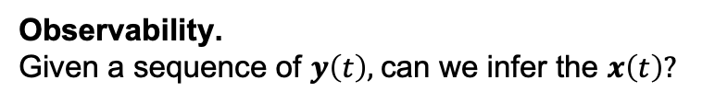
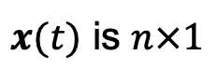
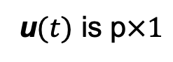
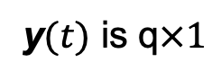
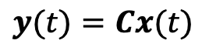
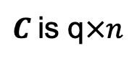
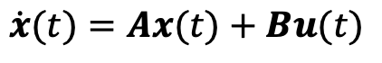
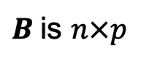
Modeling & Analysis
$$d$$
$$n$$
Controller
“Plant”
x₁, …, x_{n}
$$y$$
$$r$$
+
$$e$$
$$u$$
+
actuators
sensors
+
$$−$$
$$\dot{x}(t)=Ax(t)+Bu(t)$$
$x(t)$ is $n×1$
u$(t)$ is p$×1$
y$(t)$ is q$×1$
$$y(t)=Cx(t)$$
$A$is $n×n$
$B$is $n×p$
$C$is q$×n$
Modeling.
How construct A, B, C for a biochemical network? How accurate is the approximation?
Controllability.
For any $x(t)$ and any initial state, is there a sequence of u$(t)$ that result in $x\left(t\right)?$
Observability.
Given a sequence of $y\left(t\right),$can we infer the $x\left(t\right)?$
Full state feedback.
Design the controller u$(t)$, a function of $x(t)$, so that the closed loop outputs r.
Observer design.
Design a second closed loop system that estimates all $x(t)$ if some are unknown.
Robust control.
Design feedback control that is robust to disturbances and noise.

Slide 8
Computational Approach
Create CalTech control objects for SBML model
NonlinearIOSystem – original model
StateSpace – Linearization
Evaluate accuracy of linearization
Design controller and create NonlinearIOSystem for it
Construct a closed system by creating InterconnectedSystem with the NonlinearIOSystem for the SBML model and controller
Simulate the closed system.

Slide 9
Course Goals
Construct and analyze models of chemical networks in both continuous and discrete time, taking into account nonlinearities.
Analyze the controllability of a chemical network.
Analyze the observability of chemical networks.
Control a chemical network using full state feedback.
Construct observers for a chemical network.
Develop a robust contruct solution that addresses modeling inaccuracies and “noise” (perturbations introduced by uncontrolled factors).

Slide 10
Instructor
Joseph Hellerstein, Senior Fellow eScience Institute, Affiliate Professor CSE
PhD in Computer Science
Industry (30+ years): IBM Research, Microsoft, Google
Mathematical models of distributed computing systems
Research
Modeling evolution of microbial communities
Model Engineering (tools for building biomedical models)

Slide 11
Grading
Homework (3 assignments): 30%
Final project: 70%
End-to-end analysis and design of a feedback control of an SBML model

Slide 12
Submitting Homework
You have a folder here. Only you and the instructors have permissions for the folder.
Upload your assignment to the folder before the due date.

Slide 13
Resources
Python
Python programming
Python Data Science Handbook
Python for control engineering (Part VIII)
Control Engineering
Modern Control Engineering, Ogata
Linear Systems - Theory and Design, Chi-Tsong Chen
State Space Design (YouTube), Jake Abbott (University of Utah)
YouTube playlist for control engineering
Steve Brunton Control Boot Camp
Control Systems Design Online

Slide 14
Software
The class will feature in-class exercises, so please bring a laptop to class
Software: Tellurium (http://tellurium.analogmachine.org/)
For detailed installation instructions see https://github.com/sys-bio/tellurium#installation-instructions
For a huge database of curated models see:
https://www.ebi.ac.uk/biomodels/
Other packages
control – CalTech package for control design
controlSBML – Control design with SBML models

Slide 15
Syllabus

Slide 16
Exploring Feedback Control

Slide 17
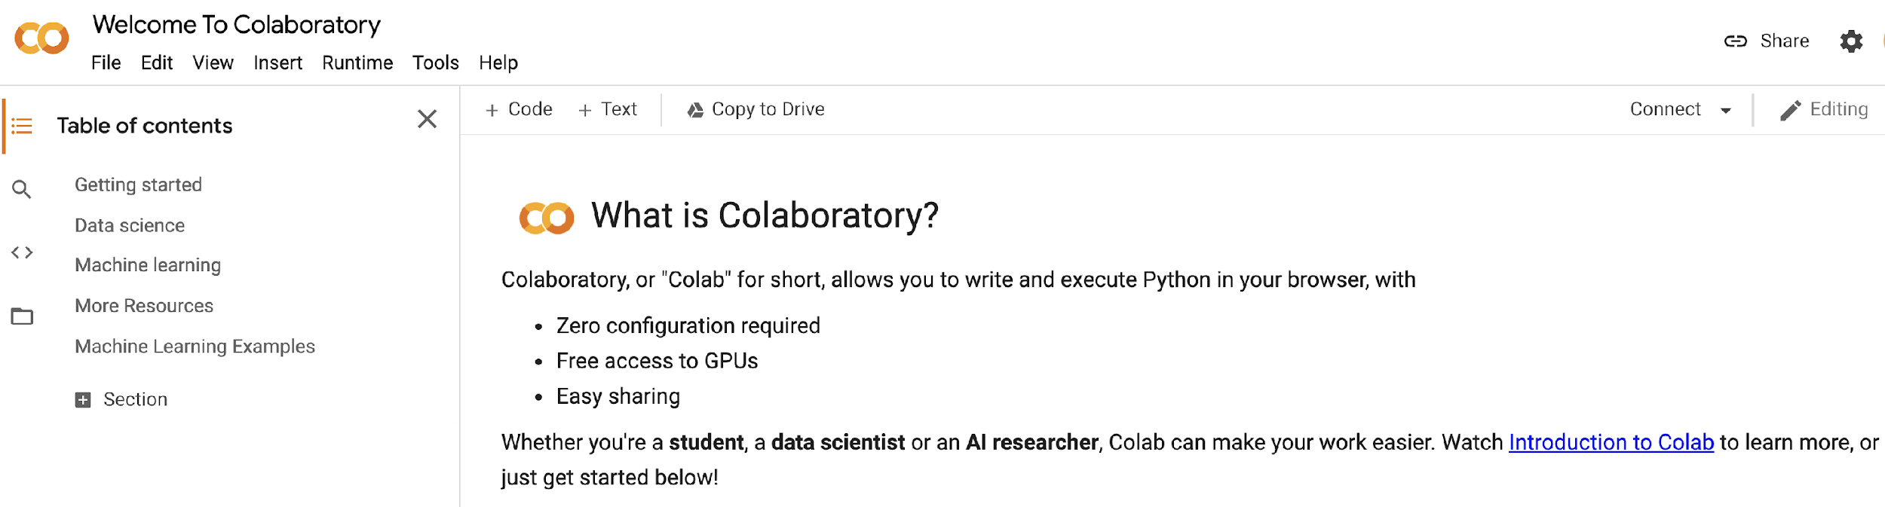
Getting Google Colaboratory (Colab)
We will use Google Colab for in-class presentation and student homeworks.
Actions: Set up Colab now on your Google Account.

Slide 18
Biochemistry Basics
Molecular biology of cells (highlights)
Enzyme kinetics – a mile high view

Slide 19
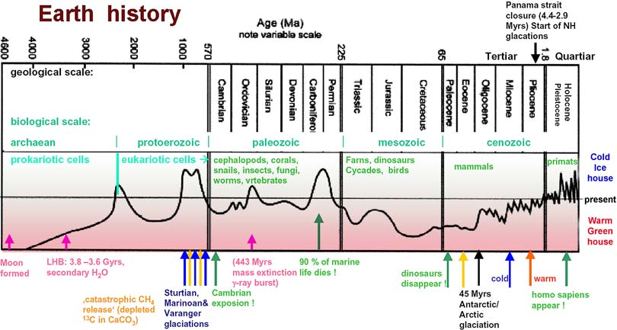
sciencemax.pbworks.com
Notes:
Simple life happened very early, within 0.5B years.
Complex cells took another 2.5B years
After Eukaryotic cells developed, quickly get multi-cellular organisms.

Slide 20
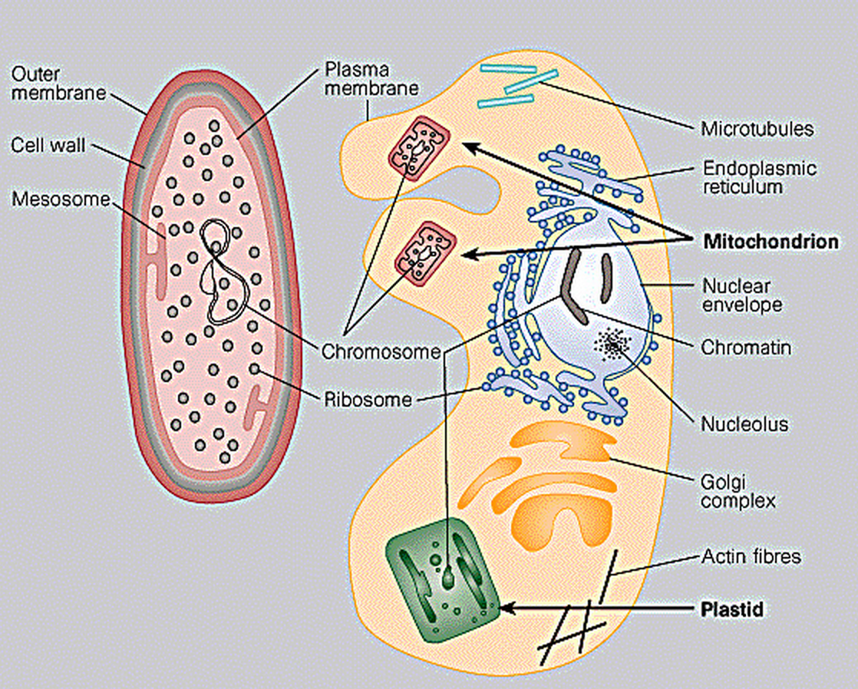
Prokaryotes (3.5B) vs. Eukaryotes (1.5B)
0.2-20 microns
0.2-20 microns
10-100 microns
10-100 microns
Prokaryote
Prokaryote
Eukaryo
Eukaryote

Slide 21
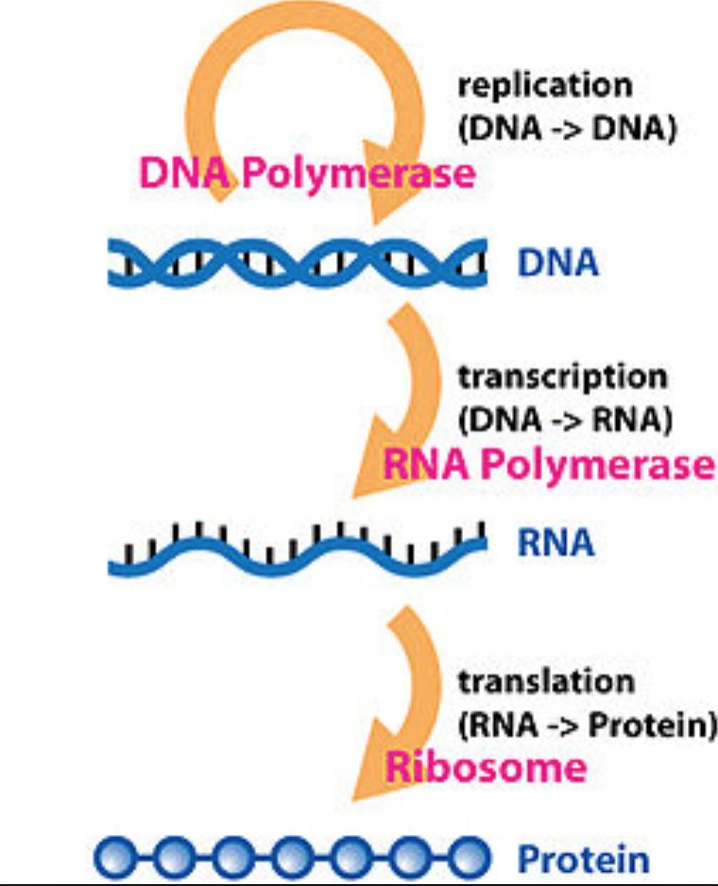
The central dogma relates DNA, RNA, and protein*.
*Wikipedia

Slide 22
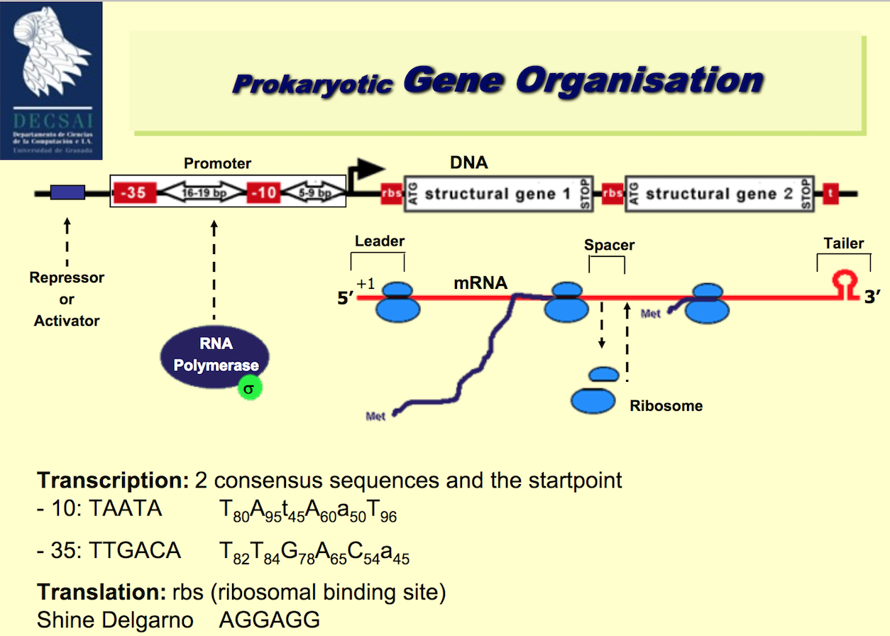

Slide 23
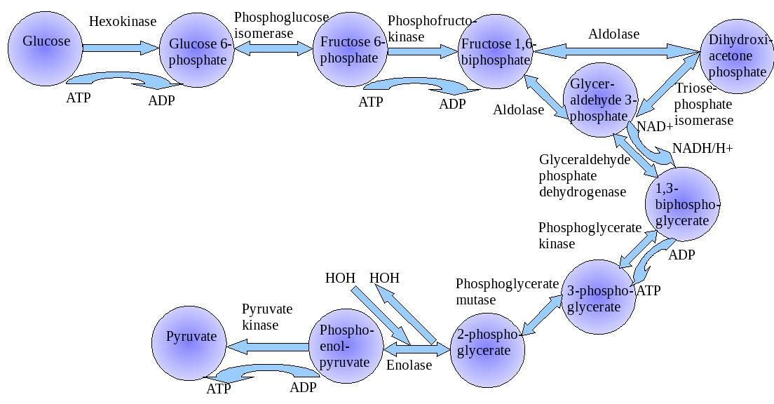
Biochemical Pathway: Collection of Reactions on Biomolecules
Glycolysis
Enzyme – protein that catalyzes a reaction

Slide 24
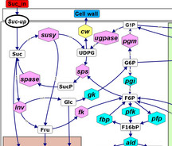
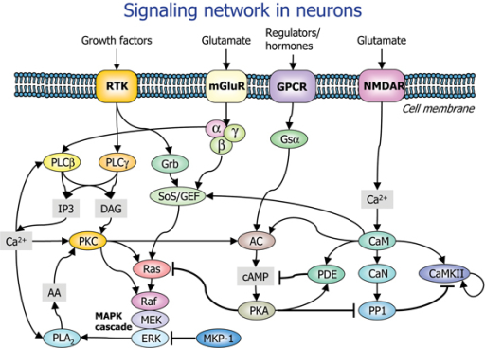
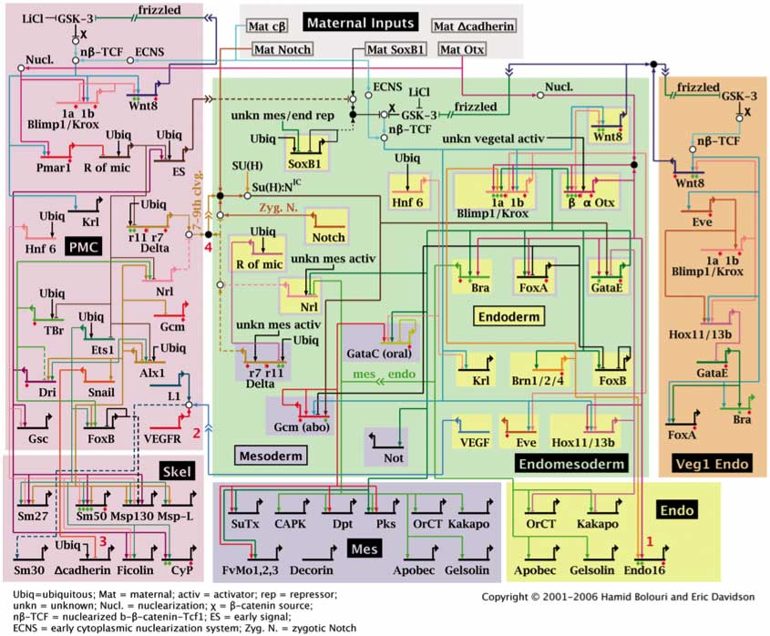
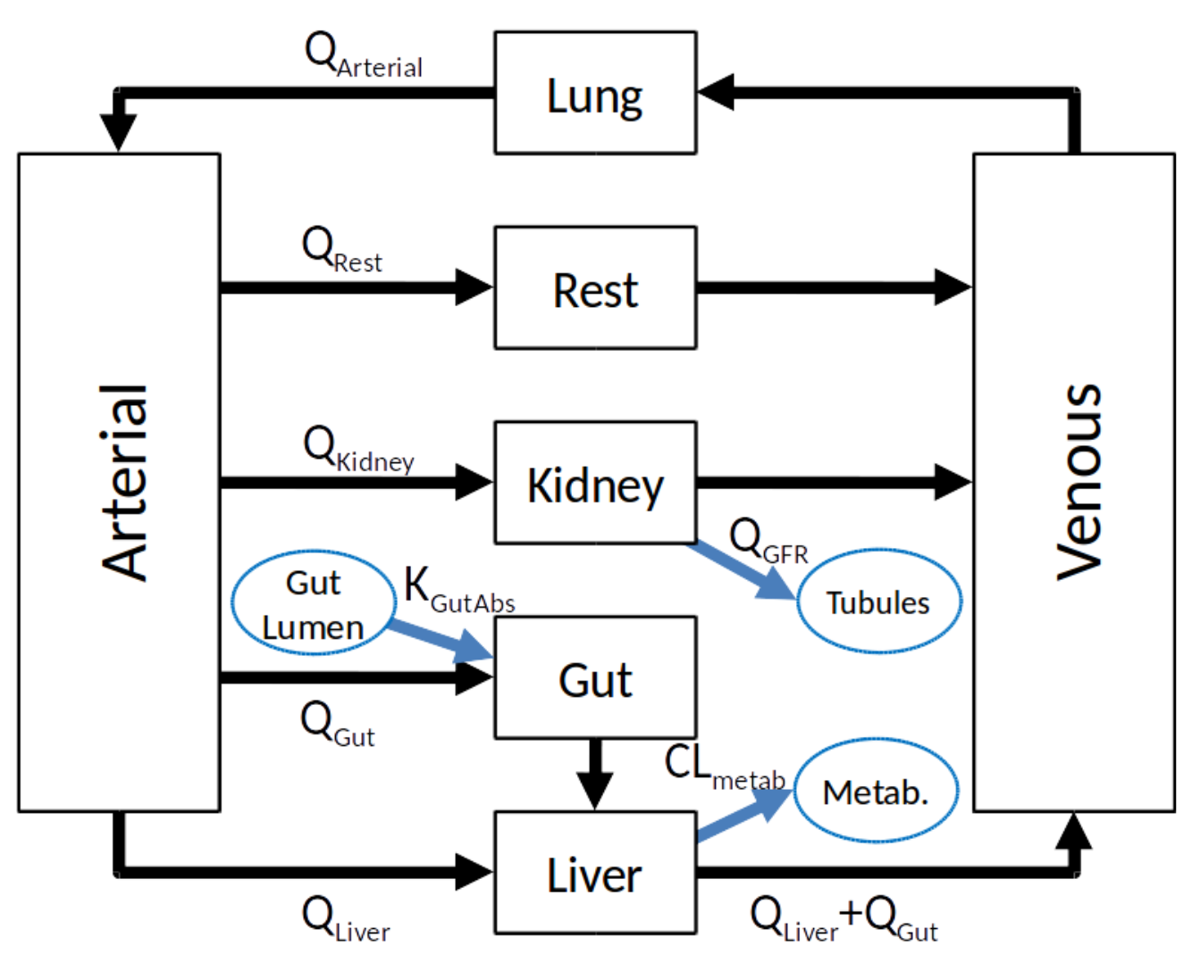
Biological Networks++
Chemical Reaction and Metabolic Networks that create and destroy chemical components of cells and tissues
Signaling Networks that transfer information between and within cells
Regulatory Networks that control the expression of genes and change cell types and behaviors
Physiologically-Based Pharmacokinetic Networks that describe the transport and processing of molecules throughout the body
++ James A. Glazier, Biocomplexity Institute Intelligent Systems Engineering, Indiana University, Bloomington, IN

Slide 25
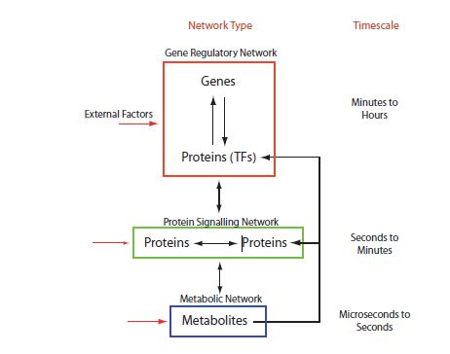
Relationships Between Types of Network++
How does the identity of the active networks in the cell change if we make a controlled change?
How does the states of the cell’s active networks and cell behaviors change if we make a controlled change?
How does the production of cell components and energy change if we make a controlled change?
++ James A. Glazier, Biocomplexity Institute Intelligent Systems Engineering, Indiana University, Bloomington, IN
Notes:
Timescale will be important when we have to simulate two of these at once or if we want to know whether we can assume a signal from one level of network to be constant or equilibrated when we are simulating another scale

Slide 26
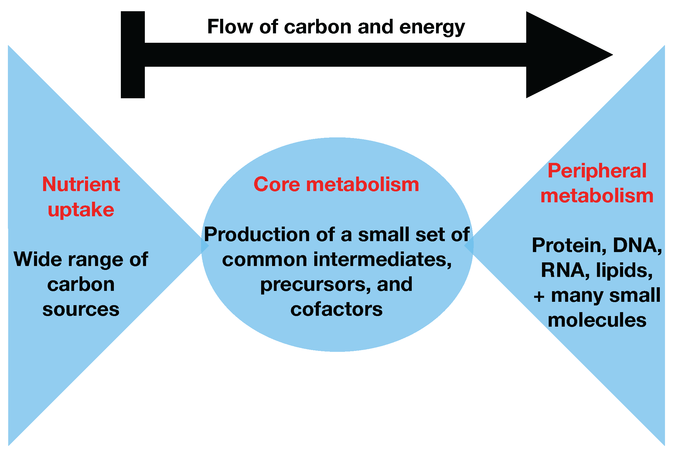
Metabolic Network++
A Metabolic network is a network of chemical reactions in a cell that transforms biomolecules to create energy, create cellular structures, and perform cellular processes.
Digestion of glucose and other nutrients into cellular components and energy production (mostly ATP—adenosine triphosphate and NADH—nicotinamide adenine dinucleotide) are the classic functions of metabolism
++ James A. Glazier, Biocomplexity Institute Intelligent Systems Engineering, Indiana University, Bloomington, IN

Slide 27
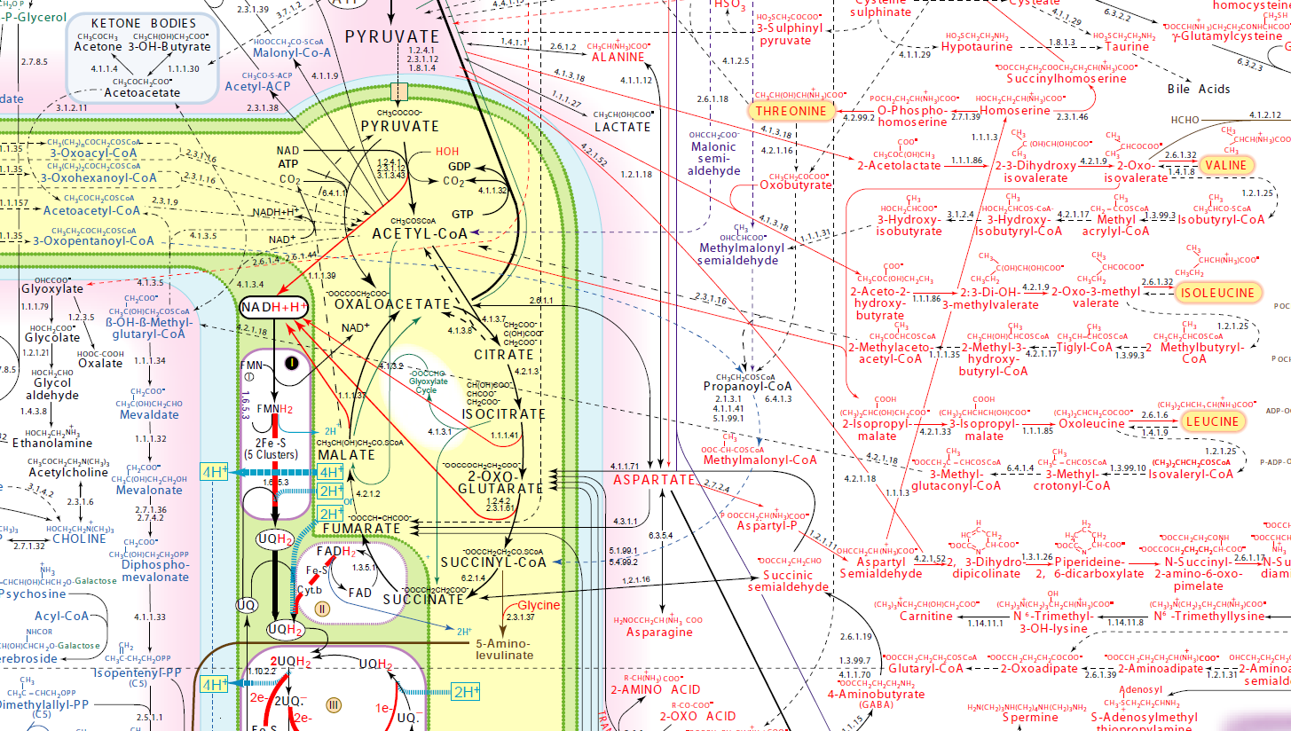
Detailed Metabolic Network
http://www.iubmb-nicholson.org/chart.html

Slide 28
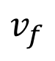
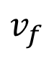
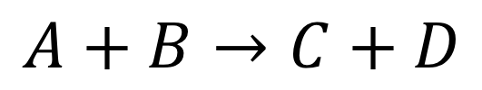
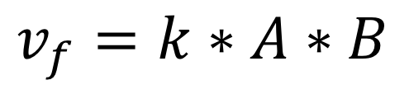
Chemical Kinetics Basics
How fast do reactions go:
Mass action kinetics
Constant times the concentrations of the reactants

Slide 29
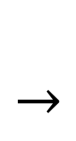
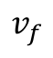
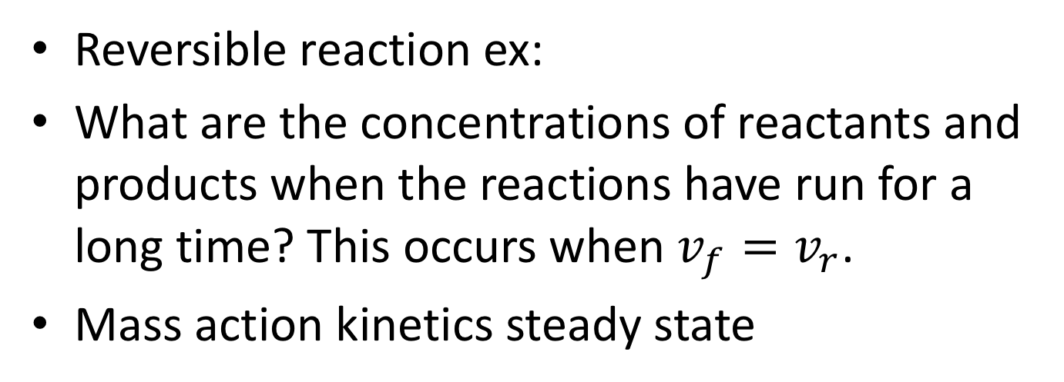
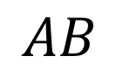
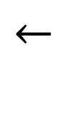
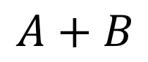
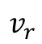
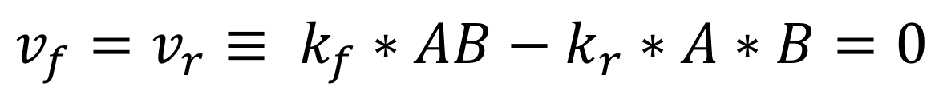
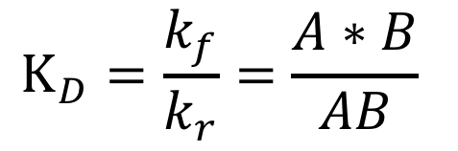
Reversible Reactions & Steady State
at steady state.
Dissociation Constant

Slide 30
Biochemical Reactions
Reactant
Molecules
Product
Molecules
Enzyme
But Arcs are often bidirectional
(since chemical reactions can be reversed)
And enzymes may be modified in pathway regulation
(self-modifying code!)
Another Enzyme

Slide 31
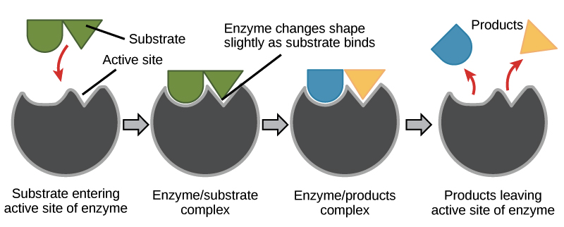
Enzymes
Proteins that accelerate biochemical reactions.
Omni-present in biology
Enzymes work by induced fit.

Slide 32
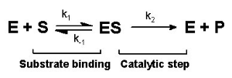
Enzymes and Reaction Kinetics
Notes:
Ask about the rates at each step.

Slide 33




Enzyme Inhibition
Competitive Inhibition
S
ES
Noncompetitive Inhibition

